Slide 1
Reading Your Report
Human Resources 5.15.2019

Slide 2
Verbatim Questions
This year the Gallup survey contained three open-ended questions so faculty and staff could leave comments and suggestions for how to improve their institution.
These questions were:
Over the next year, what should UNT System concentrate on to improve this institution as a best place to work?
What is the most important action your supervisor could take to positively impact your engagement?
What changes would you make to improve your institution?
These responses will never be made public. A summary of the feedback for every question per institution will be presented at the Fall BOR Meeting.
Only the top level of leadership will see your answers.
Notes:
These will be updated soon.

Slide 3
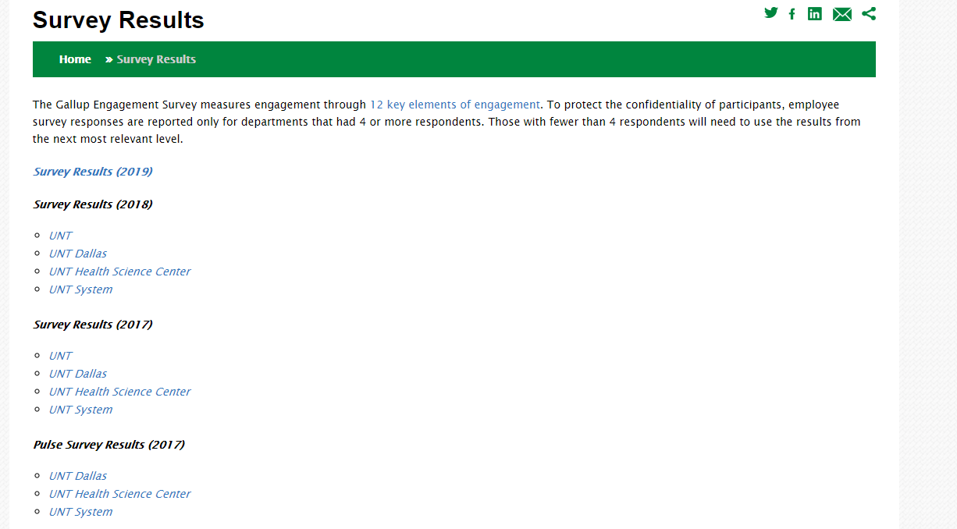
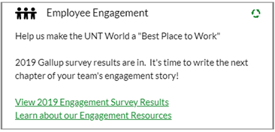
2019 UNT World Gallup Results
You can find the results by going the portal (my.unt, my.hsc, my.untdallas, my.untsystem), and clicking on the Employee Engagement pagelet. You may also go to the Employee Engagement website found at untsystem.edu/survey-results.
To view results you must enter in your EUID and system password.
Notes:
These will be updated soon.

Slide 4
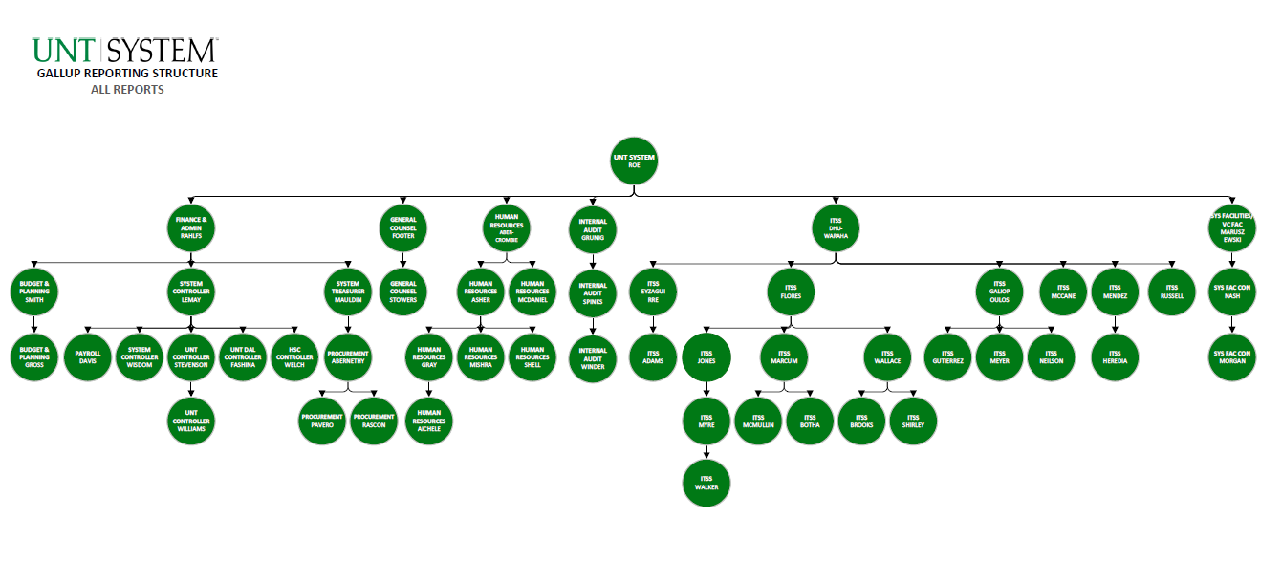
Reporting Charts
Click on the results page you wish to see. A reporting org chart will appear.
Please keep in mind that to generate a report the department must have had at least 4 respondents.
Each name on the org chart is a clickable link that will pull up the department’s results.

Slide 5
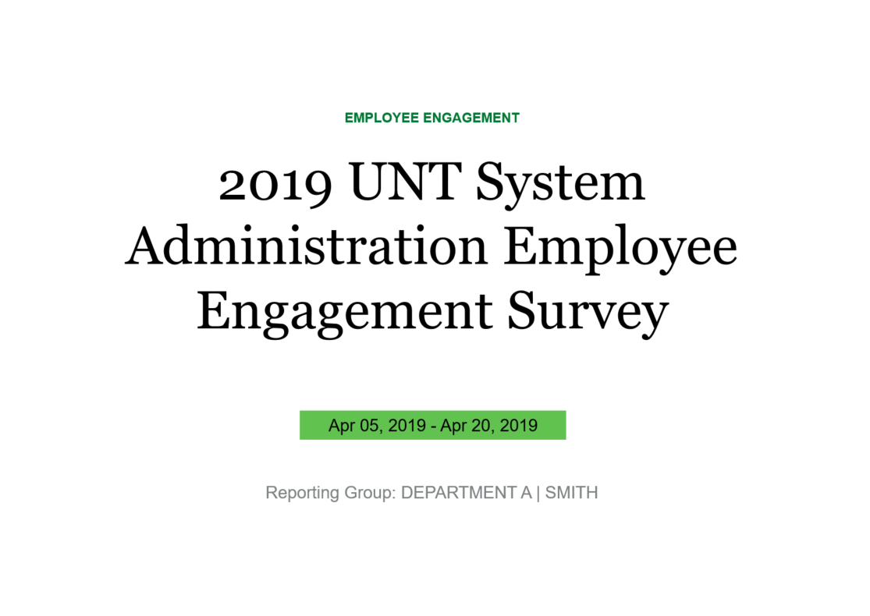
Report – Title Page
All reports come in the form of a PowerPoint. This page will have the following information:
The year of the survey & the institution this survey belongs to.
The dates the survey ran.
The department name followed by the department supervisor.
Notes:
Please keep in mind that reading your report is important, but the best managers use their engagement results to encourage dialogue and build actionable steps to make their company a better place to work.

Slide 6
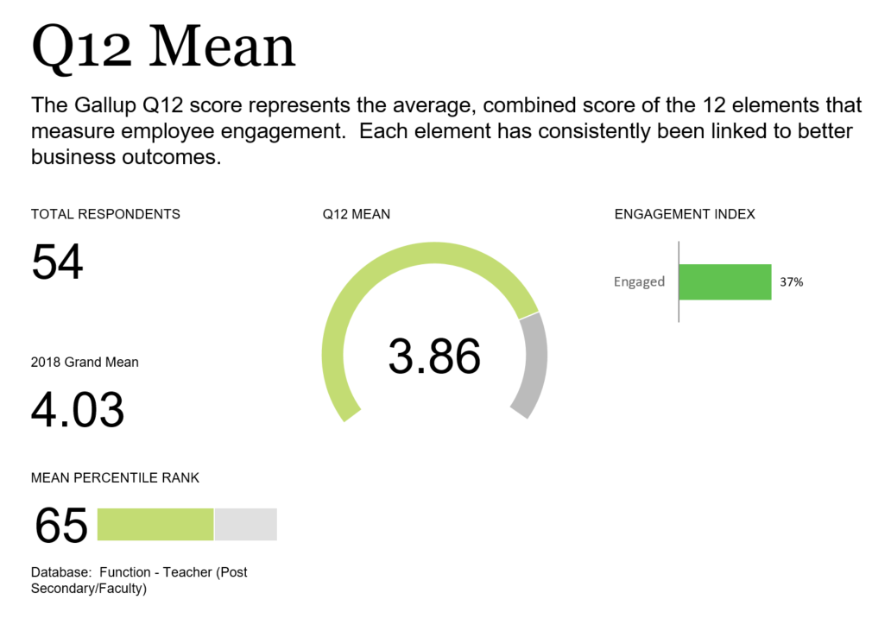
Q12 Mean
This Mean is the sum of all the Q12 responses. Q12 Mean and 2018 Grand Mean are synonymous.
Based on the responses to the Q12, Gallup has a formula to calculate the # of engaged employees.
When your total respondent n=30 or higher you can see the Engaged %. If the n=100 or higher you will see Engaged, Not Engaged & Actively Disengaged.
This is our benchmarking data.
We are compared to 80,000 other responses from higher education institutions that include staff & faculty.
Notes:
2018 Grand Mean – If they had fewer than 10 respondents last year, they will not have a 2018 mean. OR if their department has changed significantly, they will not have this data available.
Mean Percentile Rank – We score higher than 65% of all other participating institutions in this database.
Engagement Index – if n=29 or fewer there will be no data here. Comes up again in Slide 13 if you have enough respondents.

Slide 7
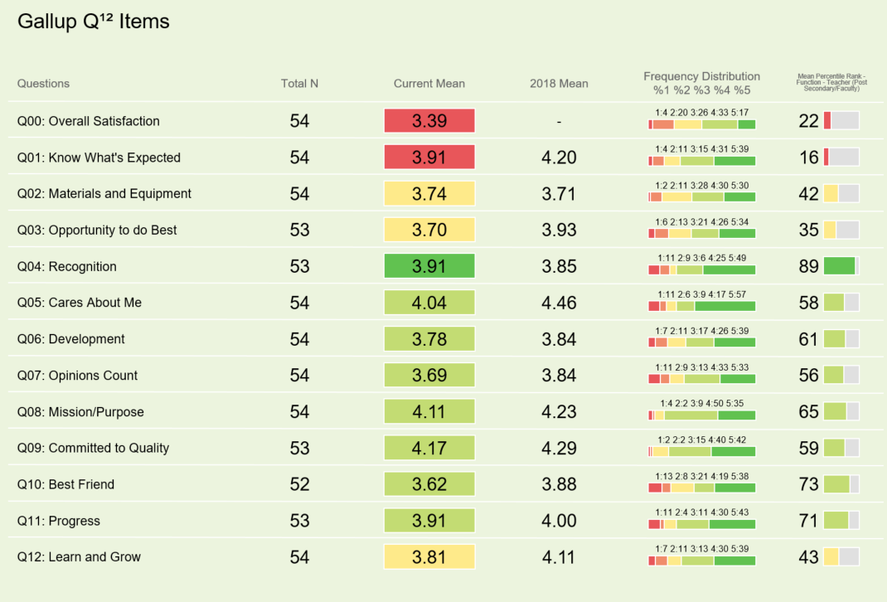
Gallup Q12 Snapshot
This is a quick look at all of your Q12 response Means for this year, and if applicable, 2018.
This column shows the breakdown percentages of respondents for the 5 point scale.
This is the total number of respondents per question.
This is the first year we have included this question. No one will have 2018 data.
These are your percentile rankings against the benchmarking data we selected.
Notes:
None of the Q12 questions were required to have answers so there may be a varying number of responses based on the Q. Best Friend tends to have the least amount of responses.
Frequency Distribution: For ex in Q1: 39% selected 5.00 (the highest score), 31% selected 4.00, 15% selected 3.00, 11% selected 2.00, and 4% selected a 1.00.

Slide 8
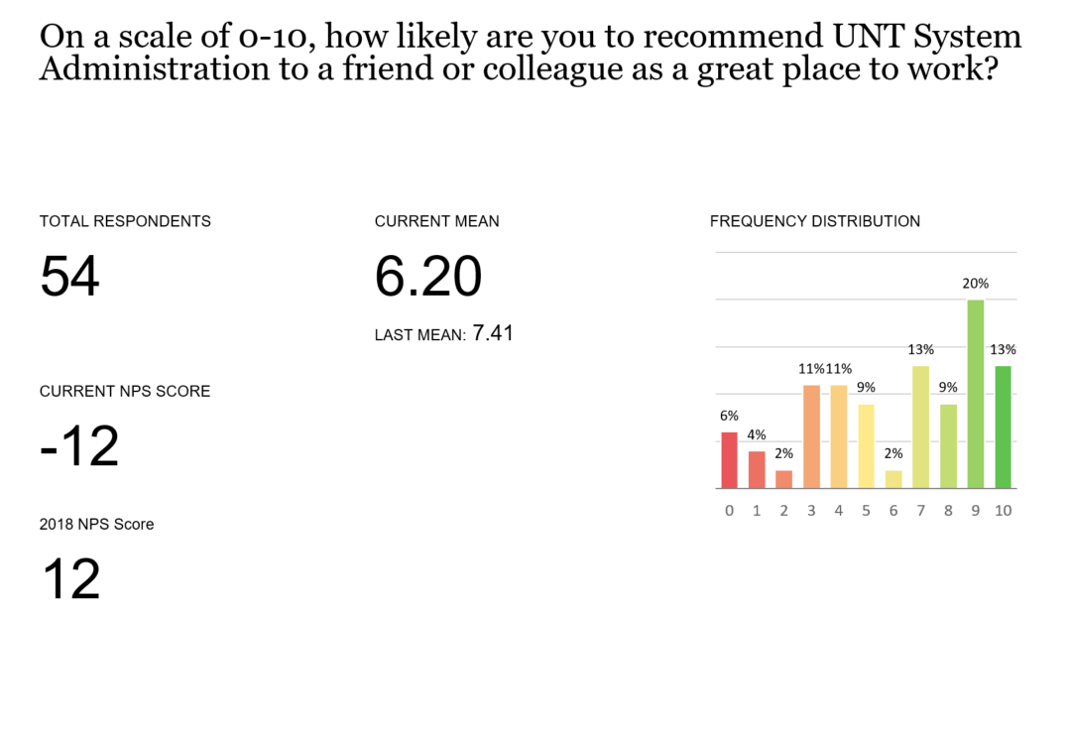
Employee Net Promoter Score (NPS)
This is a custom question added to our Gallup survey. The NPS is a metric used to assess employee loyalty.
You will not receive this information if you have fewer than 10 responses.
This is the average of all the responses for your team.
Employees who respond with a 9 or 10 are knows as Promoters.
Employees who respond with a 7 or 8 are known as Passives.
Employees who respond with a number between 0-6 are known as Detractors.
This is the 2018 Mean. Depending on how many respondents you had last year, this number may be N/A.
This score is calculated subtracting your Promoter% from your Detractor%.
Notes:
To calculate NPS Score lets look at the frequency distribution. You have a combined 33% for your Promoters. Ignore the Passives. You have a combined 45% for your Detractors. Subtract your Promoters from your Detractors. 33-45 = -12.
NPS Scores range from -100 to +100. Benchmarking against yourself is the best rule of thumb, but 0 is considered an average score.

Slide 9
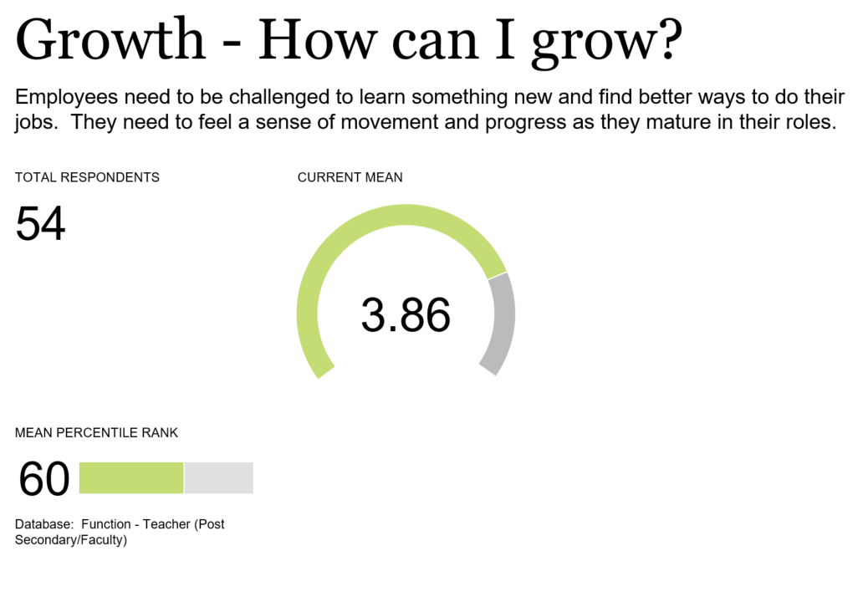
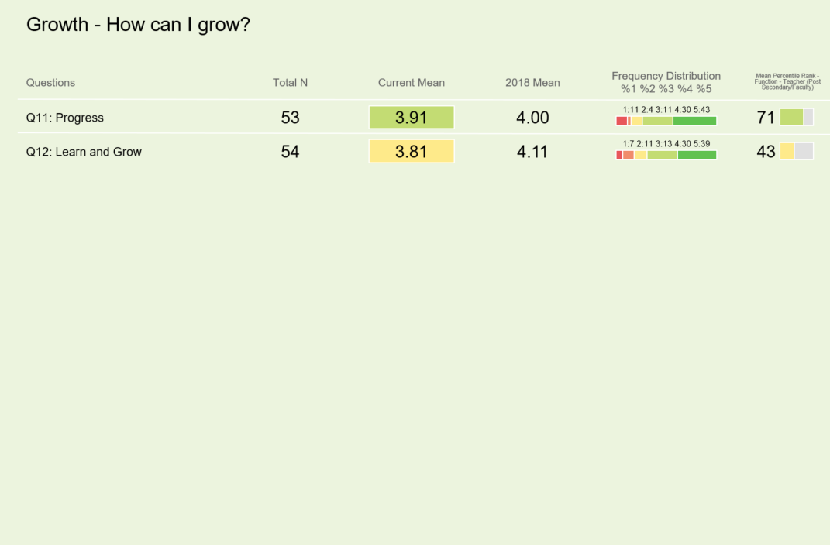
Growth
Mean of 2019 Q11 & Q12 responses.
Notes:
The deep dive into the Q12 are separated by Gallup’s Employee Engagement Hierarchy. It starts with Basic Needs -> Individual-> Teamwork -> Growth.

Slide 10
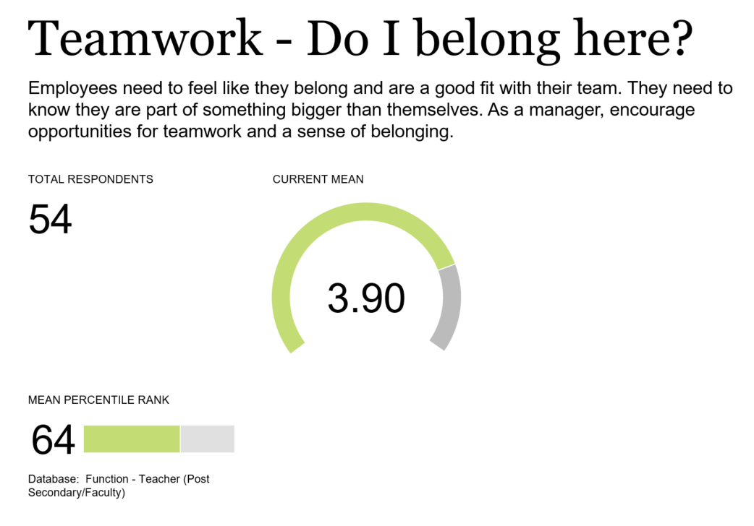
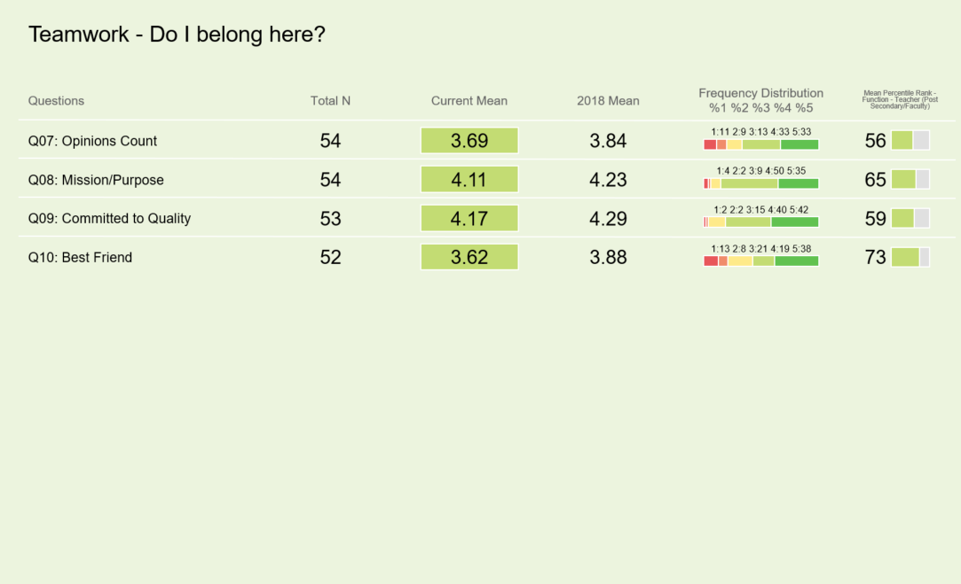
Teamwork
Mean of 2019 Q7-Q10.

Slide 11
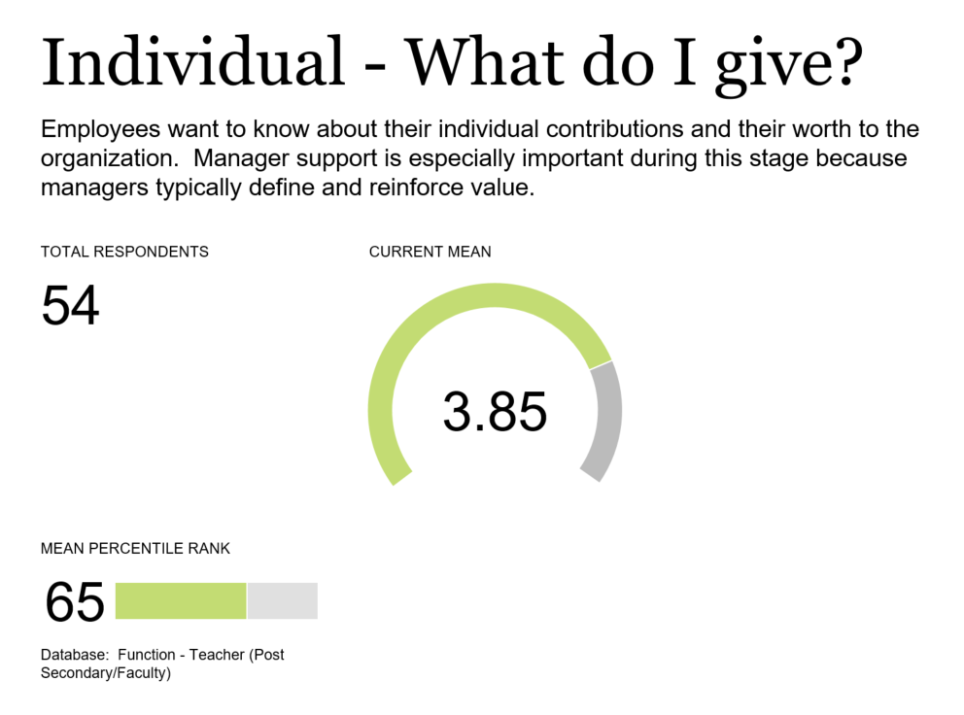
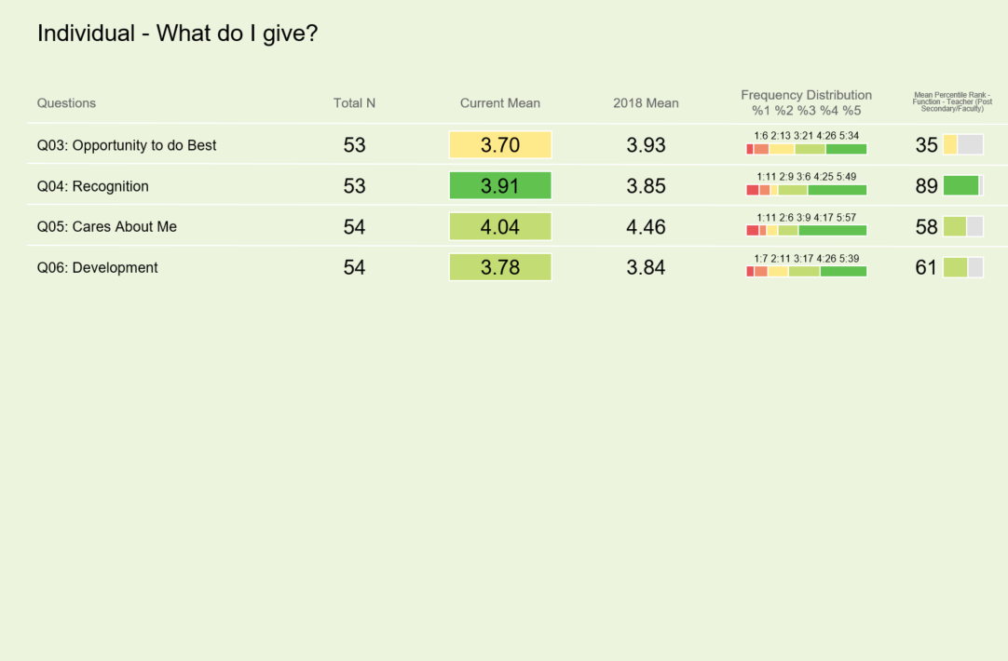
Individual
Mean of 2019 Q3-Q6.

Slide 12
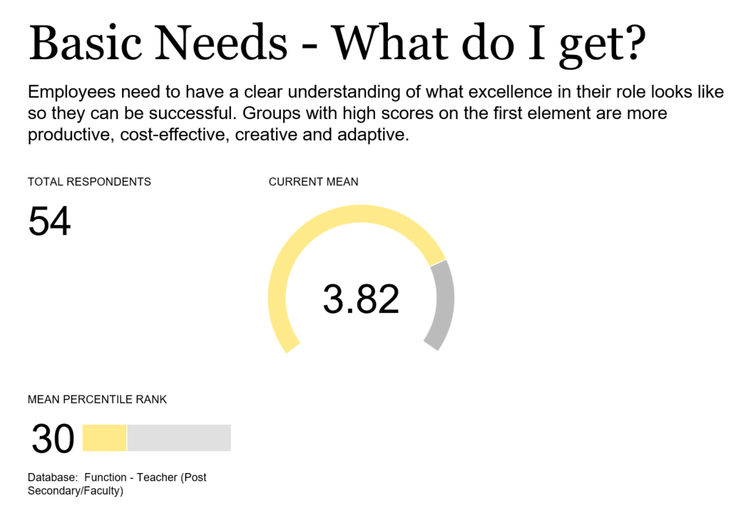
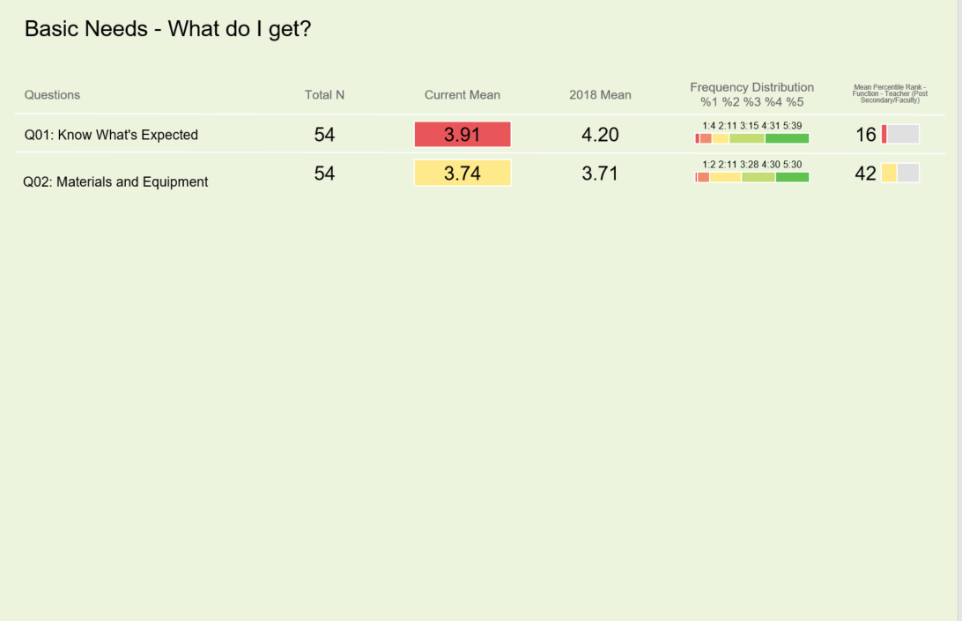
Basic Needs
Mean of 2019 Q1 & Q2.
Notes:
Basic Needs – Individual needs – Teamwork – Growth

Slide 13
Engagement Index
Notes:
Will give you definitions of each category. The canoe example. Engaged – row forward. Not engaged – along for the ride. Actively Disengaged – rowing backwards.

Slide 14
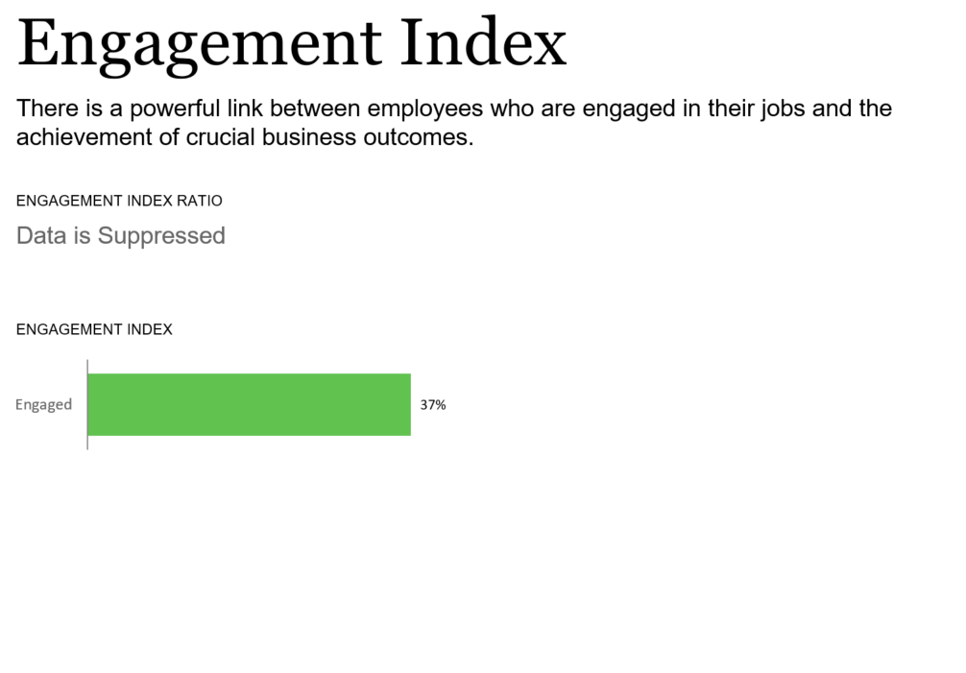
Engagement Index
Notes:
This group has fewer than 100 respondents so we will only see one portion. Those with more will get a better look at their engagement numbers. This is to protect anonymity.

Slide 15
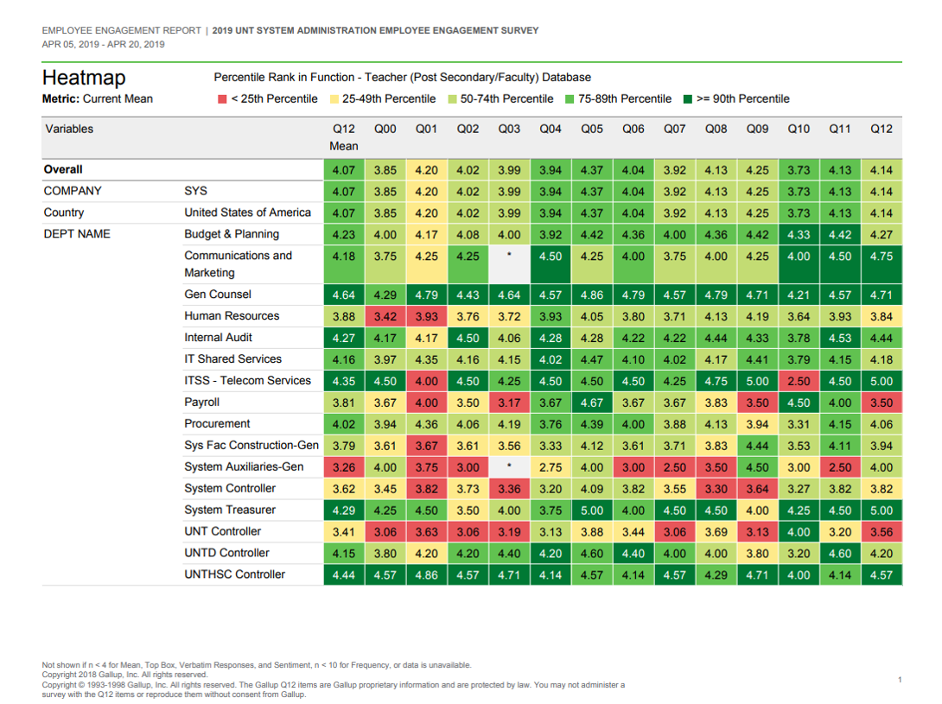
Heatmap
This is a snapshot of the overall institution by department.
All three of these rows will be the overall institution’s results.
Notes:
Length of Heatmap will vary based on institution. System is 1 page, UNT is several.

Slide 16
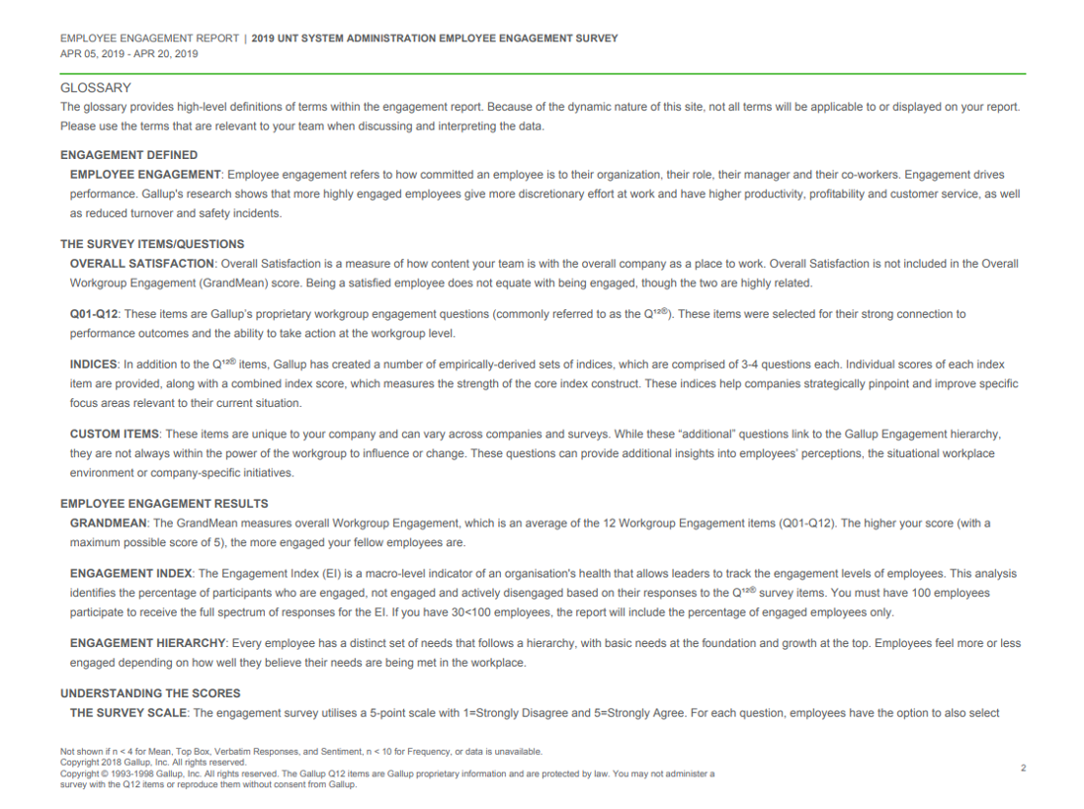
Glossary

Slide 17
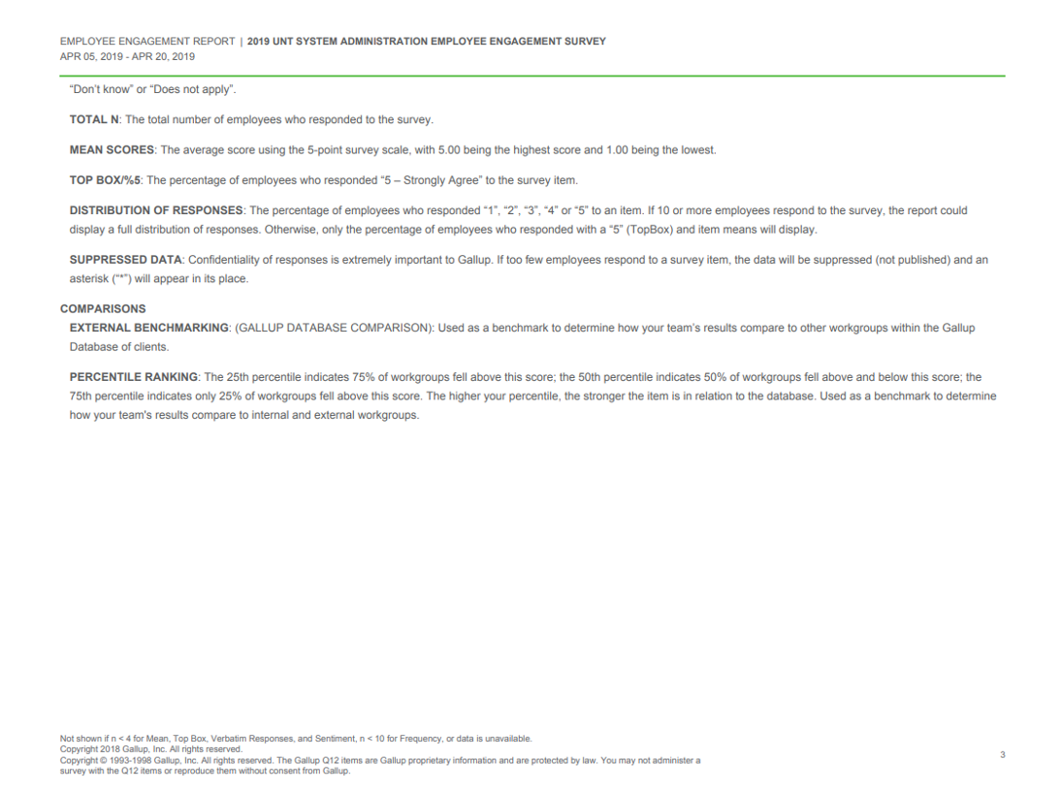
Glossary

Slide 18
Questions/Comments?
Please contact your Campus HR Team.
UNT - AskHR@untsystem.edu
UNT Dallas & UNT System - HR@untdallas.edu
UNT Health Science Center - HSC.HR@untsystem.edu

