Slide 1
The Drought: Food Deserts In America
TBL Group 13: Marc Esquivel, Joseph Collins, Jason Herrington, Princess Ananti, Ashton Terry, Henry Nguyen

Slide 2
What is the problem
Lack Access to Nutritional foods
Chronic disease ( Diabetes, Obesity, CVD)
Decreased life expectancy
Increased Healthcare spending
Notes:
The United States Department of Agriculture defines a Food desert “as parts of the country vapid of fresh fruit, vegetables, and other healthful whole foods, usually found in impoverished areas. This is largely due to a lack of grocery stores, farmers’ markets, and healthy food providers”.
Webster's dictionary defines a food desert as “an area where little fresh produce is available for sale”.

Slide 3
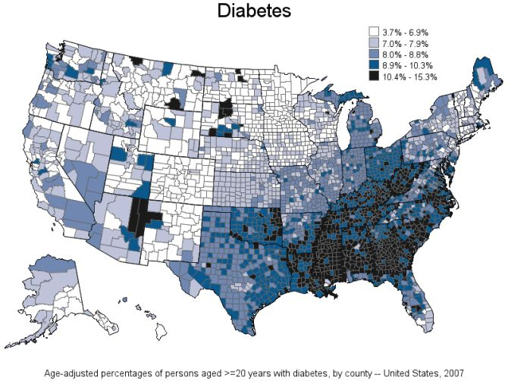
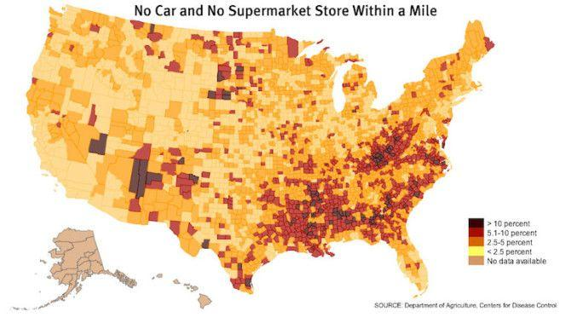
Food Desert Demographics
Notes:
50% of these food deserts are in low income areas that wouldnt be able to afford healthy foods and they have about 2.5 times more exposure to fast food and convenient stores with rates of diabetes doubled than areas with large grocery stores

Slide 4
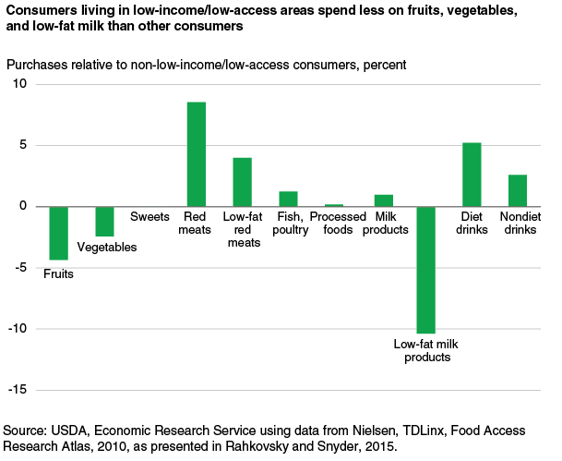
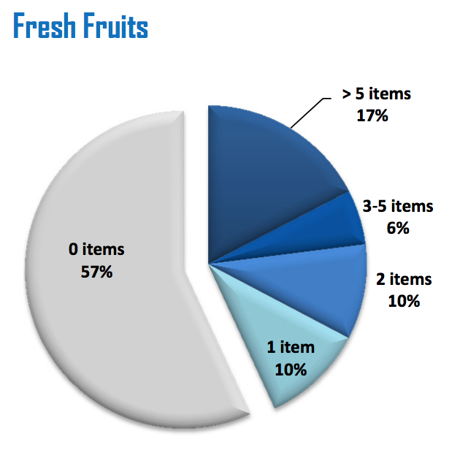
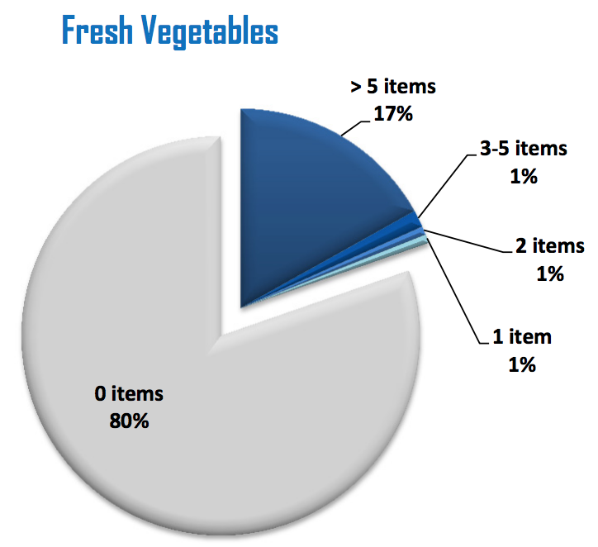
Food Desert Demographics
Tarrant County Example:
Out of 11 total zip codes surveyed, 4 of them had ZERO grocery stores
https://access.tarrantcounty.com/content/dam/main/public-health/12-19-2013FOOD_DESERT_final_report.pdf
Notes:
The four zip codes without any grocery stores showed the least availability of healthy foods.
Fresh Fruits:
57% of the stores did not have any fresh fruit
17% of all the stores had more than five fruits available
Fresh Vegetables:
80% of the stores did not have any fresh vegetables
Dairy milk was the most available food
Most of the convenience stores sold fruits and vegetables by piece making it more expensive
17% of the stores had more than five vegetables available
https://access.tarrantcounty.com/content/dam/main/public-health/12-19-2013FOOD_DESERT_final_report.pdf

Slide 5
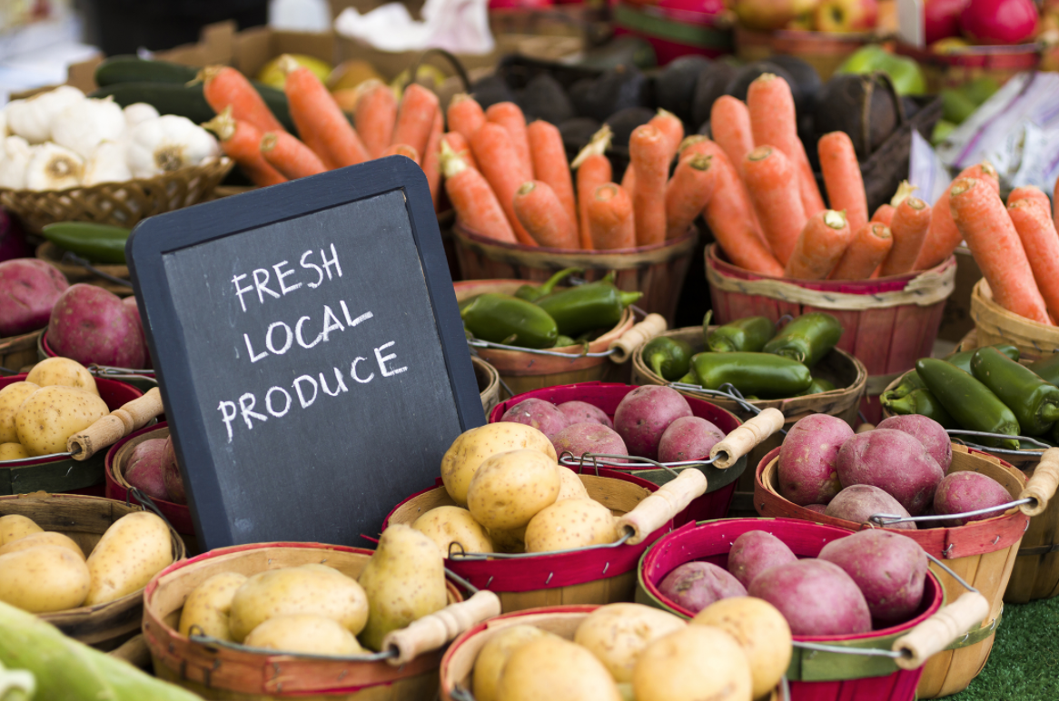
Community Market
Where people pay what they can to get what they need!!!!
Products
Fresh fruits and vegetables
Healthy food options
Payment
Cash donations
Donate food
Free if needed

Slide 6
Community market
Disseminate information
Healthy eating habits
Healthy lifestyle choices
Local health organizations
Health awareness events
Funding
Grassroots organizations
Local businesses
Local Government
National food chains
Location
School
Church
Community center
Volunteers
PTA
Grassroots organizations
YMCA
Notes:
Millennials are mostly motivated by passion for a cause, so when spreading the word about your charity, concentrate on your mission, not the institution itself. With that in mind, motivate young people to get involved by showing them that they are able to make a difference.

Slide 7
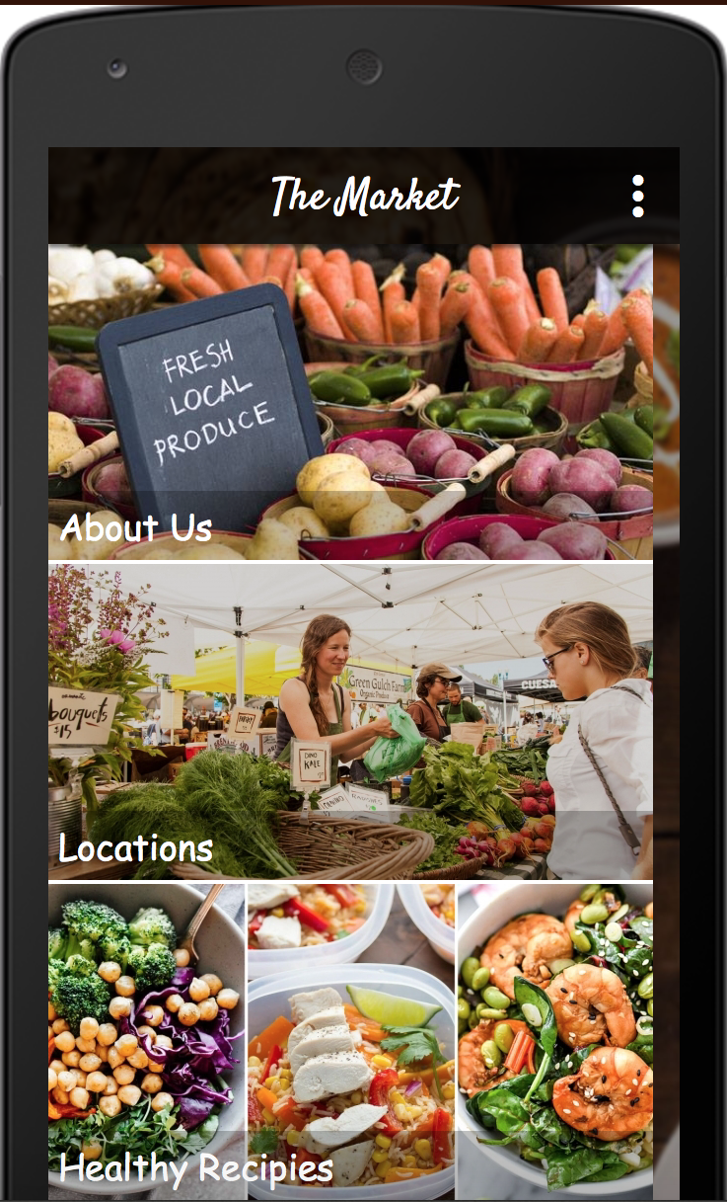
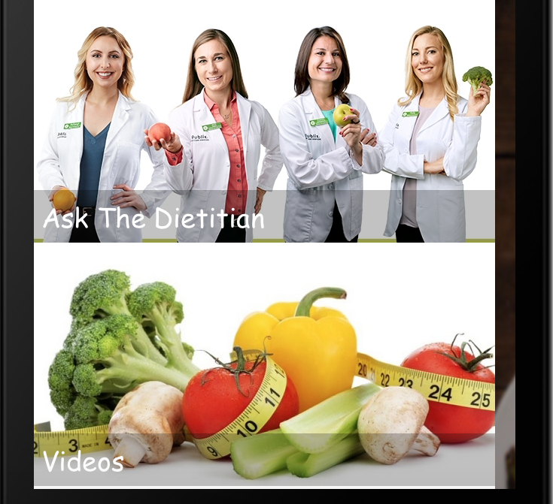
The App
Sections:
About Us
Locations
Healthy Recipes
Ask the Dietitian
Videos
Notes:
With technology being a staple for success in today’s society, we can link our business model with an app. Smartphones have become a great tool that people already have and can utilize. This free app run by advertisements would have multiple sections and facets in order to facilitate and educate people about healthy living. While there are health apps that exist already, this app will integrate directly with our community farmer’s markets. The biggest portion of this app would allow communities to upload the dates and locations of local farmers markets to keep people in these food deserts informed.

Slide 8
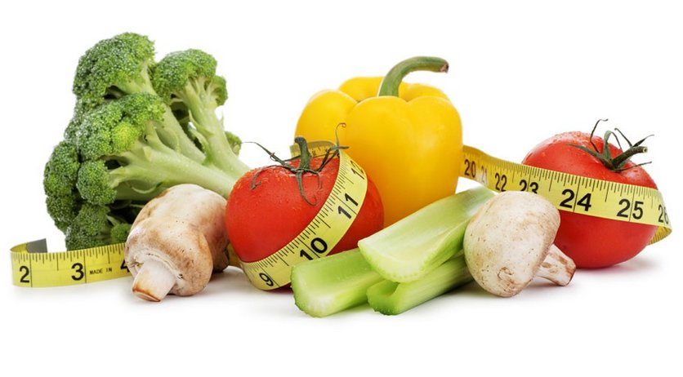
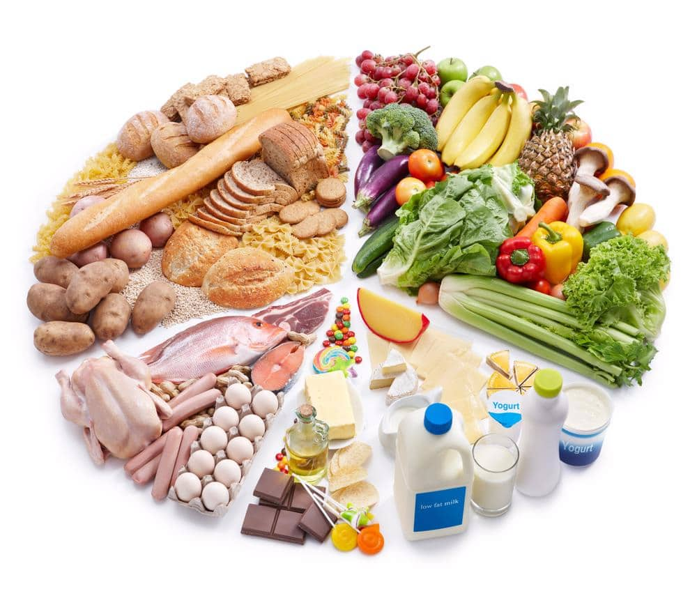
Lifestyle Education
Notes:
Not only will this app cover where to access healthy foods, it will provide the education portion that is crucial for a healthy lifestyle. This app will have sections on healthy recipes and video education tools about healthy habits like nutrition and exercise. Lastly, this app will have a section titled “Ask the Dietician” where there will be FAQ’s about healthy eating. This section will also have an option to call or video chat with a dietician for a fee to ask any questions. After personally working with a dietician student in the SAGE program through the university, I have been able to see first hand how a dietician can provide a crucial service to achieve a healthy lifestyle. The dieticians will be specifically trained to provide solutions for those individuals that reside in those food deserts. This app is important because it provides access as well as education.

Slide 9
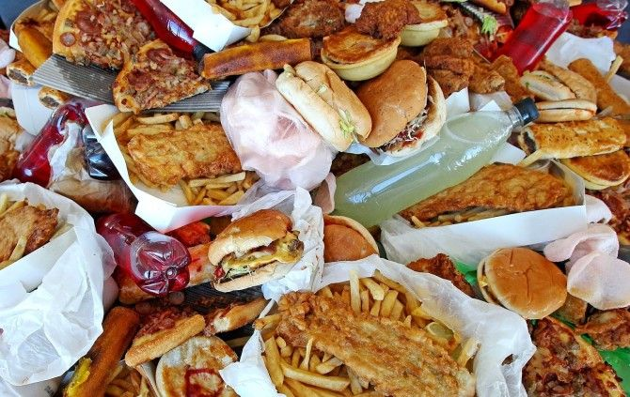
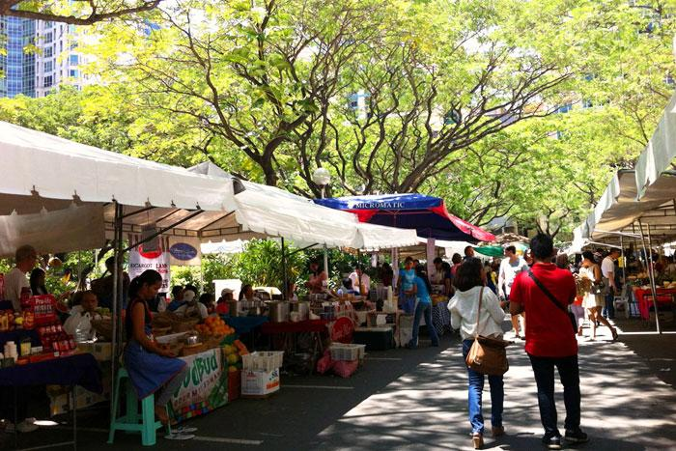
Conclusion
Food deserts lack access to nutritional foods with higher access to fast foods
They consist of a majority of low-income citizens
They have twice the obesity rates as areas with large grocery stores
Leads to complications such as HTN, Hyperlipidemia, increase blood sugar, diabetes, stroke, and heart disease
Incorporate community markets ran by volunteers and local community
Can provide fresh fruits and vegetables to food deserts
Does not translate into behavior change
Using apps to educate people on healthy living and where/how to find access to healthy foods within their community
Notes:
Apps can be funded by the advertisements within the app
Community markets, dieticians/nutritionist can be funded by insurance companies
It may be more cost-effective to prevent obesity than to treat the complications of obesity

